Slide 1
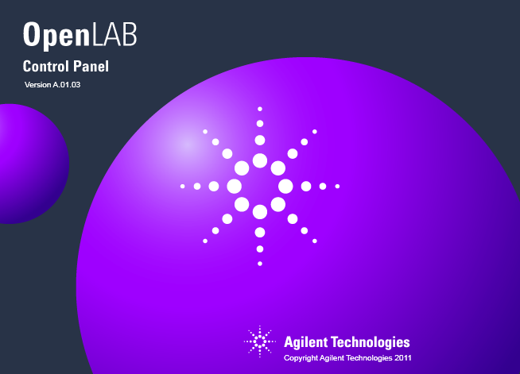
OpenLAB CDS
Shared Services
Level 1 Training
AN-CE-NDS-1-149-x
Module 1:
OpenLAB CDS Introduction
Abel De Oliveira
Product Support Engineer
Software and Informatics Division / LPAD-LSG

Slide 2
What is OpenLAB CDS?
OpenLAB CDS provides a common navigation layer while maintaining the instrument control interfaces that customers are used to using today.
3 major components comprise OpenLAB CDS:
      OpenLAB CDS Shared Services
      OpenLAB CDS EZChrom Edition
      OpenLAB CDS ChemStation Edition
      OpenLAB CDS serves as the new version of both EZChrom
      and multi-technique ChemStation:
      Supports latest LC and GC modules
      ChemStation supports single quad LC/MS
      QQQ, QTOF, and GC/MS stay on MassHunter and Mustang respectively.

Slide 3
What is OpenLAB CDS?
  Bring in a shared services layer interface
  Keeping instrument interface/workflow the same
  Provide Scalability based on common installable components
EZChrom CDS Workflow
EZChrom Data Analysis
EZChrom Sequencing
EZChrom storage/ECM
Multi-Vendor Control
Shared Services
Instrument Navigation Project Navigation
User management permissions
User Authentication
Software Diagnostics
Shared Components
Common Reporting
Common Drivers
Easy Sequence Wizard
ChemStation CDS Workflow
ChemStation Data Analysis
ChemStation Sequencing
ChemStation storage/ECM/Data Store
Notes:
3

Slide 4
Shared Services: Functions
Instrument Management
Create/edit instruments and instrument access
Central instrument status overview including activity logbook
Projects Management
Access security for data stored “in” projects
Manage application user privileges per project
Users / Groups / Roles Management
User authorization
Manage users and user groups
User privileges (roles)
Network Communication Infrastructure
Communication between different components of a C/S system
Diagnostics Infrastructure
Software diagnostics and tracing
Support for workstation as well as C/S systems
License Management
Application independent license management
Supports license server infrastructure
Customer portal for license management
Notes:
Two main functions:
Administration: creation and configuration of instruments, management of group / projects / users
Multi-instrument view: Centrally manage access to instrument and view the instrument status.

Slide 5
OpenLAB CDS Scalability
Enterprise OpenLAB CDS with ECM Enterprise
Distributed
OpenLAB CDS with ECM / Data Store Workgroup
Increasing Users/Instruments
Distributed CDS-File based
(EZChrom Only)
Networked Workstations
Workstations
Increasing Functionality
Notes:
Same look and feel independent of scalability
Supports scaling (lab at a glance)

Slide 6
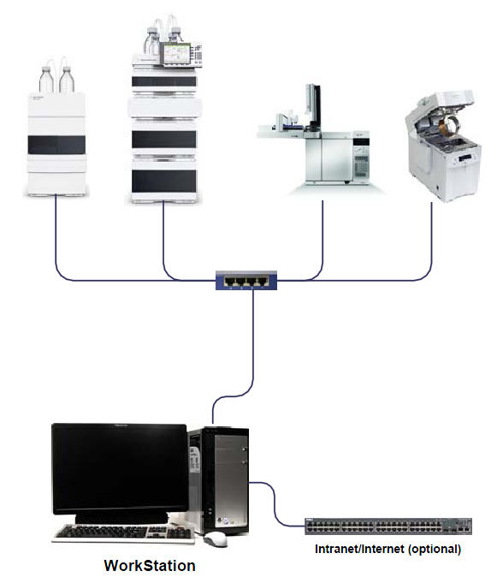
Supported Topologies
Standalone Workstation
EZChrom or ChemStation
Up to 4 instruments per workstation
Administration and instrument management
Two or more standalone workstations can be on the same network, but they need to be managed independently.
Notes:
EZChrom and ChemStation can be installed as workstations. The application and the OpenLAB CDS Shared Services are installed on the same computer. Up to 4 instruments can be configured on the workstation.

Slide 7
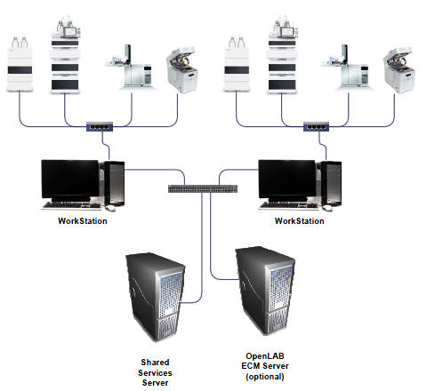
Supported Topologies
Networked Workstation
EZChrom or ChemStation
Central administration, license and instrument management
Up to 4 instruments per networked workstation
Central status overview for all instruments
ChemStation – local disk storage only.
EZChrom – central file storage only
OpenLAB Server must reside on a dedicated server and not an instrument workstation
File
Server
EZChrom
only
Notes:
EZChrom and ChemStation can be installed in Networked workstation. Up to 4 instruments can be configured on the workstation. The OpenLAB Shared Services server must reside on a dedicated server and not an instrument workstation .
Data storage is a local one for ChemStation and a central one for EZChrom.
Advantage over Standalone: License and user administration is done in one central place.

Slide 8
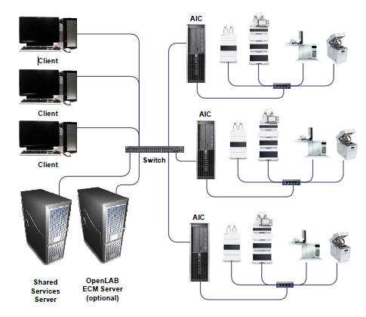
Supported Topologies
Distributed CDS (Simple)
Central Administration and Instrument management
Remote access of instruments & data processing via network using CDS Clients
EZChrom Edition :
  Up to 4 instruments per instrument controller (AIC)
  Central file storage
ChemStation Edition:
  Up to 10 instruments per instrument controller (AIC)
  ECM is mandatory
Notes:
Instruments and data processing are accessed remotely via the network from Client computers.
Every client can access every instrument.

Slide 9
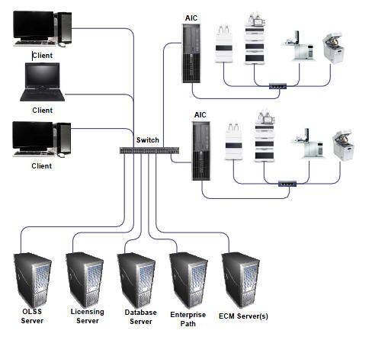
Supported Topologies
Distributed CDS (Complex)
Following components may be hosted on independent machines
Shared Services
Licensing
Database
Storage Path for EZChrom (Enterprise path/Project root)
Notes:
This topology is available for EZChrom only. Up to 4 instruments can be defined per instrument controller. Instruments and data processing are accessed remotely via the network from Client computers.

Slide 10
Supported Topologies
Standalone Compliant Workstation
ChemStation only, introduced with revision C.01.06.
Up to 4 instruments per workstation
Administration and instrument management locally
Local backend (Data Store) for CFR Part11 compliance.
Notes:
This is the equivalent of the ChemStation Plus solution (ChemStation + ChemStore standalone + Security Pack).

Slide 11
Summary
  New common navigation interface (OpenLAB Control Panel)
  Provides nearly identical front end workflows for both ChemStation and EZChrom Editions.
  A Variety of configurations are available from a common installer model in order to support customer needs with a minimum set of software components.
  System Scalability
→ Next Up: OpenLAB CDS Installation

